Slide 1
Applied Statistics with Application in Finance
TOPIC
Prediction of S&P 500 Close Price using Volatility (VIX)
Chandra Gopi Reddy, MS(FA) Abhimanyu Sheth, MS(FA) Jayesh Kartik, MS(FA)
Dheeraja Katram, MS(FIN)

Slide 2
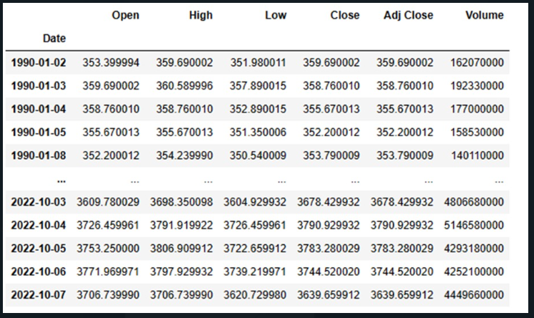
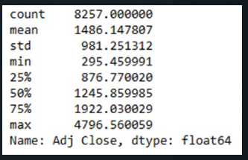
S&P
S&P 500 index serves as a statistical gauge of the performance of the 500 largest stocks in the United States.
The S&P 500 serves as a common standard against which the performance of a portfolio can be measured

Slide 3
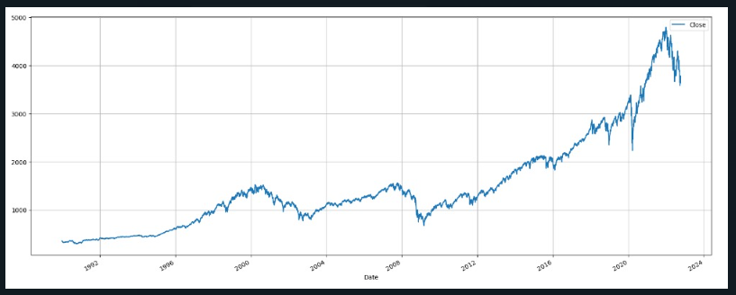
Close Price Movement of S&P
Time Frame Considered-32 years

Slide 4
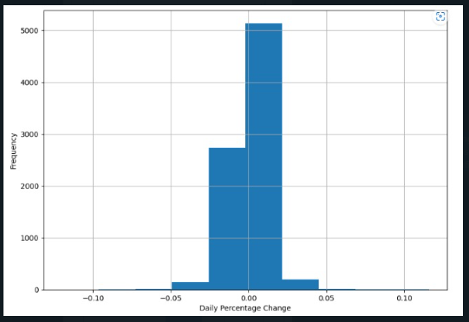
Daily Percentage Change in the S&P 500 Closing Prices

Slide 5
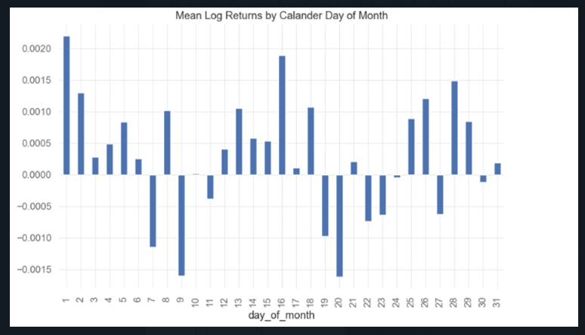
Mean log closing price returns
Source-Yahoo Finance

Slide 6
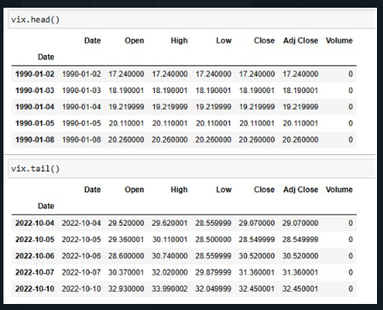

VIX
The market's expectations for the relative strength of impending price swings of the S&P 500 Index are reflected in the Volatility Index (VIX), a live index (SPX).
Volatility, or how quickly prices fluctuate, is frequently used to assess market emotion, particularly the level of anxiety among traders.

Slide 7
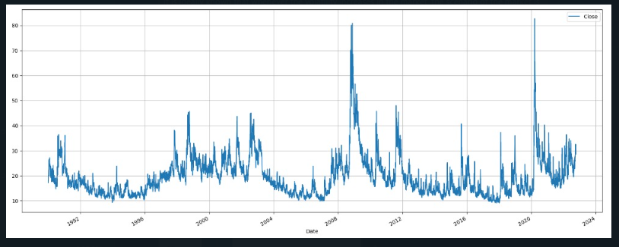
The movement of VIX data Close Price in the last 32 years-

Slide 8
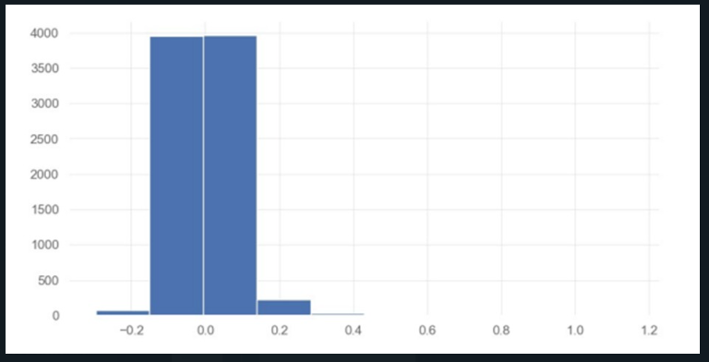
Daily Percentage change in VIX’s Closing Price-

Slide 9
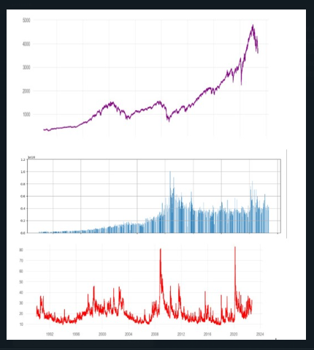
Comparison of the movement of S&P 500 and VIX
S&P 500 and VIX
Dependent Variable- Volume and Close
Independent Variable- Volatility

Slide 10
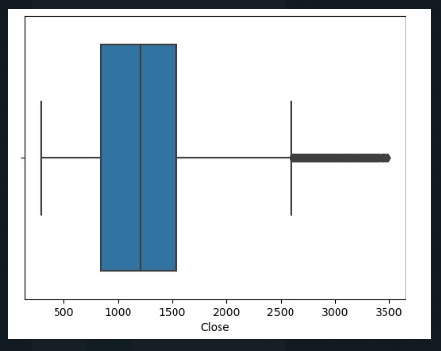
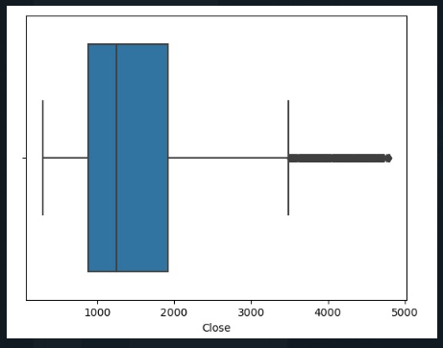
Managing and Dealing with the Outliers of S&P Data-
BEFORE
AFTER

Slide 11
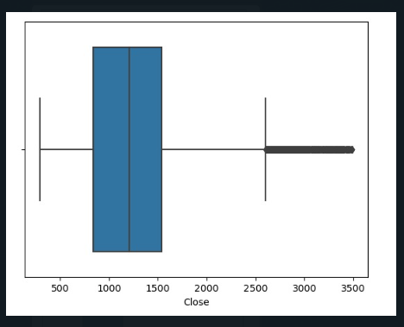
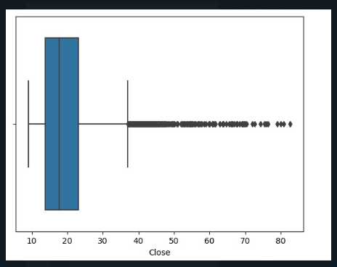
Managing and Dealing with the Outliers of VIX Data-
BEFORE
AFTER
BEFORE
AFTER

Slide 12
CORRELATION
Correlation is a statistical measure that expresses the extent to which two variables are linearly related (meaning they change together at a constant rate). It’s a common tool for describing simple relationships without making a statement about cause and effect.

Slide 13
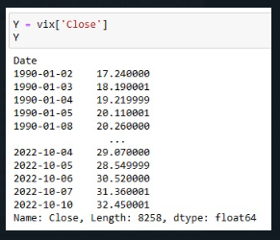
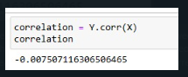
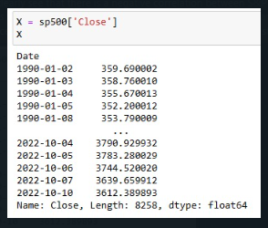
CORRELATION OF S&P 500 Close and VIX Close Price

Slide 14
CORRELATION OF S&P 500 Close and VIX Close Price

Slide 15
BOLLINGER BANDS
Bollinger Bands are great to observe the volatility of a given stock over a period.
The volatility of a stock is observed to be lower when the space or distance between the upper and lower band is less.
Similarly, when the space or distance between the upper and lower band is more, the stock has a higher level of volatility.

Slide 16
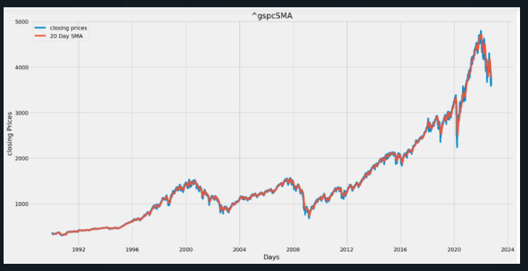
APPLICATION OF BOLLINGER BANDS
UPPER_BB = STOCK SMA + SMA STANDARD DEVIATION * 2.5
LOWER_BB = STOCK SMA - SMA STANDARD DEVIATION * 2.5

Slide 17

BENEFITS OF BOLLINGER BANDS
Bollinger Bands help you identify sharp, short-term price movements and potential entry and exit points
Bollinger Bands are visually easy to interpret
They can be used both as a volatility indicator.
Bollinger Bands can be applied to any underlying asset across any time frame
The indicator generates signals that not only provide precise entry levels but also specify stop loss and take-profit zones

Slide 18
APPLICATION OF BOLLINGER BANDS
UPPER_BB = STOCK SMA + SMA STANDARD DEVIATION * 2.5
LOWER_BB = STOCK SMA - SMA STANDARD DEVIATION * 2.5

Slide 19

BACK TESTING
BACKTESTING
Back testing involves applying a strategy or predictive model to historical data to determine its accuracy.
It can be used to test and compare the viability of trading strategies so traders can employ and tweak successful strategies.
It allows traders to test trading strategies without the need to risk capital.
Common back testing measures include net profit/loss, return, risk-adjusted return, market exposure, and volatility.

Slide 20
RESULTS OF BACK TESTING
Link to the Tear sheet-
https://drive.google.com/file/d/1iete-PKCP90kL7KK76TBJdQc-69T2VIg/view?usp=share_link

Slide 21
ARCH Model
An ARCH (autoregressive conditionally heteroscedastic) model is a model for the variance of a time series.
ARCH models are used to describe a changing, possibly volatile variance.
Although an ARCH model could possibly be used to describe a gradually increasing variance over time, most often it is used in situations in which there may be short periods of increased variation.

Slide 22
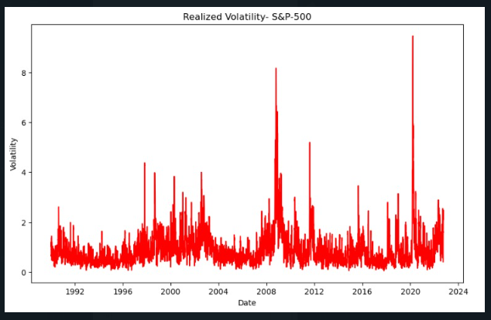
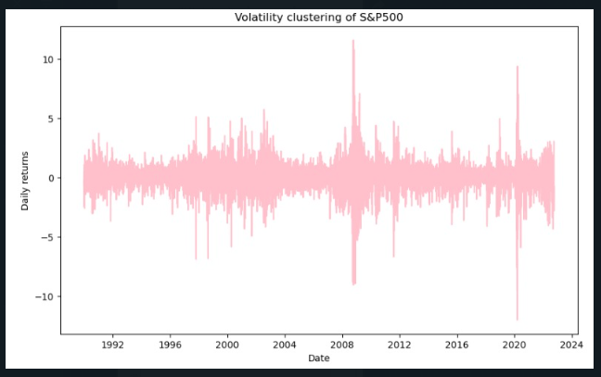
Results of ARCH Model

Slide 23
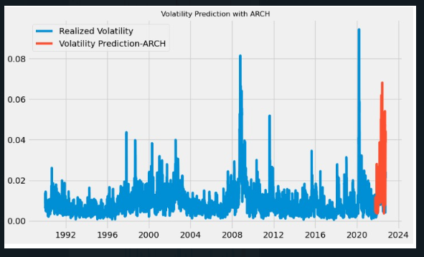
Prediction of Volatility by Arch Model

Slide 24
Regression Analysis (Simple linear)
Relationship
Equation form
Assumptions
Benefits

Slide 25
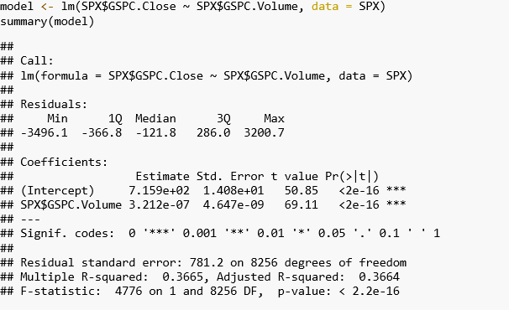
Regression Analysis (Result)

Slide 26
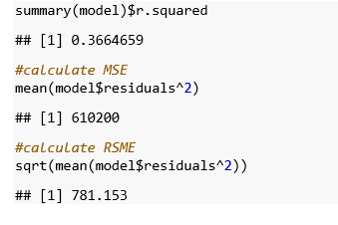
Regression Analysis Error

Slide 27
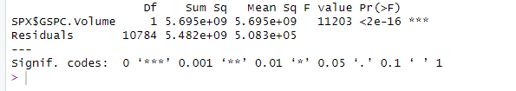
ANOVA Hypothesis Testing Result

Slide 28
THANKYOU

